Slide 1


Análisis e Interpretación de Datos
Dr. Raúl V. Ramírez Velarde
Linear Regression and Inference

Slide 2
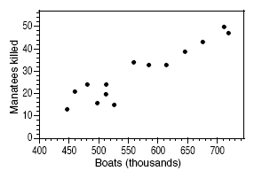

The data in a scatterplot are a random sample from a population that may exhibit a linear relationship between x and y. Different sample ➔ different plot.
Now we want to describe the population mean response μ_{y} as a function of the explanatory variable x: μ_{y} = β₀ + β₁x.
And to assess whether the observed relationship is statistically significant (not entirely explained by chance events due to random sampling).

Slide 3
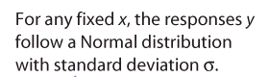
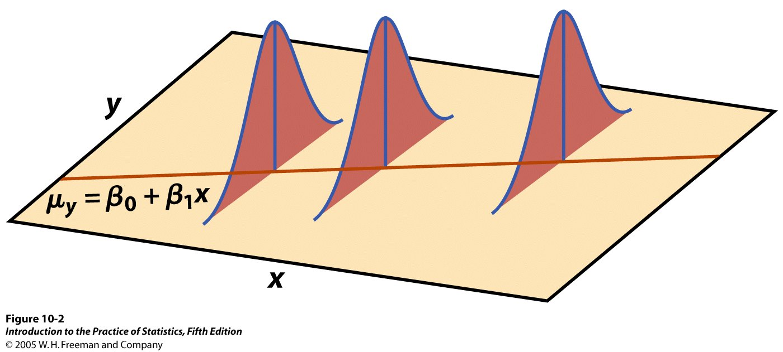
Simple linear regression model
In the population, the linear regression equation is μ_{y} = β₀ + β₁x.
Sample data then fits the model:
Data = fit + residual
y_{i} = (b₀ + b₁x_{i}) + (ε_{i})
where the ε_{i} are independent and Normally distributed N(0,σ).
Linear regression assumes equal variance of y (σ is the same for all values of x).

Slide 4
The population standard deviation σ for y at any given value of x represents the spread of the normal distribution of the ε_{i} around the mean μ_{y} .
The regression standard error, s, for n sample data points is calculated from the residuals (y_{i} – ŷ_{i}):
s is an unbiased estimate of the regression standard deviation σ.

Slide 5
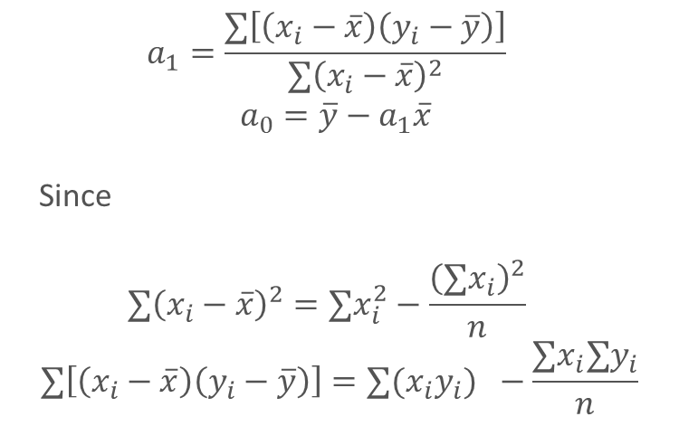
Linear Regression Coefficient Estimate
$$a_{1}=\frac{∑\left[\left(x_{i}−\overline{x}\right)\left(y_{i}−\overline{y}\right)\right]}{∑{\left(x_{i}−\overline{x}\right)}^{2}}$$
$$a_{0}=\overline{y}−a_{1}\overline{x}$$
Since
$$∑{\left(x_{i}−\overline{x}\right)}^{2}=∑x_{i}^{2}−\frac{{\left(∑x_{i}\right)}^{2}}{n}$$
$$∑\left[\left(x_{i}−\overline{x}\right)\left(y_{i}−\overline{y}\right)\right]=∑(x_{i}y_{i}) −\frac{∑x_{i}∑y_{i}}{n}$$

Slide 6
Goodness of Fit

Slide 7
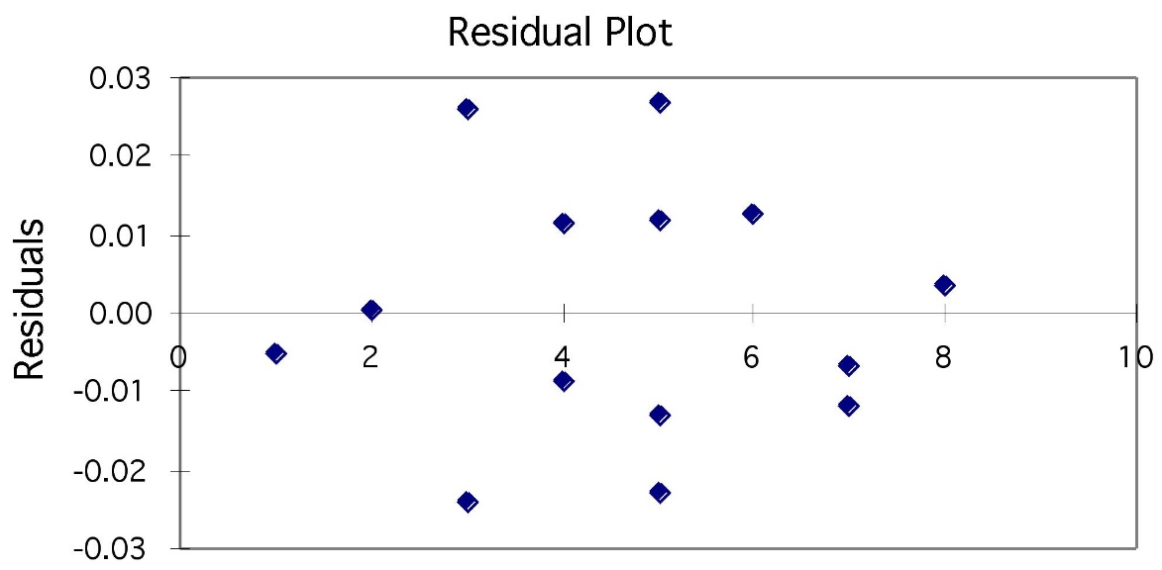
Using residual plots to check for regression validity
The residuals (y − ŷ) give useful information about the contribution of individual data points to the overall pattern of scatter.
We view the residuals in a residual plot:
If residuals are scattered randomly around 0 with uniform variation, it indicates that the data fit a linear model, have normally distributed residuals for each value of x, and constant standard deviation σ.

Slide 8
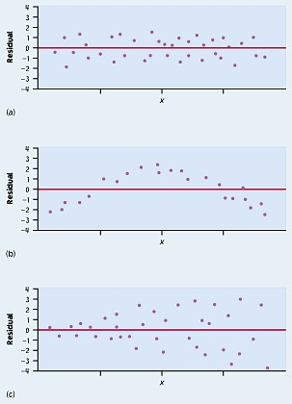
Heterocedasticidad
Heterocedasticidad
Residuals are randomly scattered → good!
Curved pattern → the relationship is not linear.
Change in variability across plot → σ not equal for all values of x called Heterokedasticity

Slide 9

Residual analysis
The residuals are standardized with their standard error:
The standardized residuals
are standardized such that they resemble the normal distribution with mean zero and standard deviation one—if the model assumptions hold.
Models are usually validated with a residual plot.

Slide 10
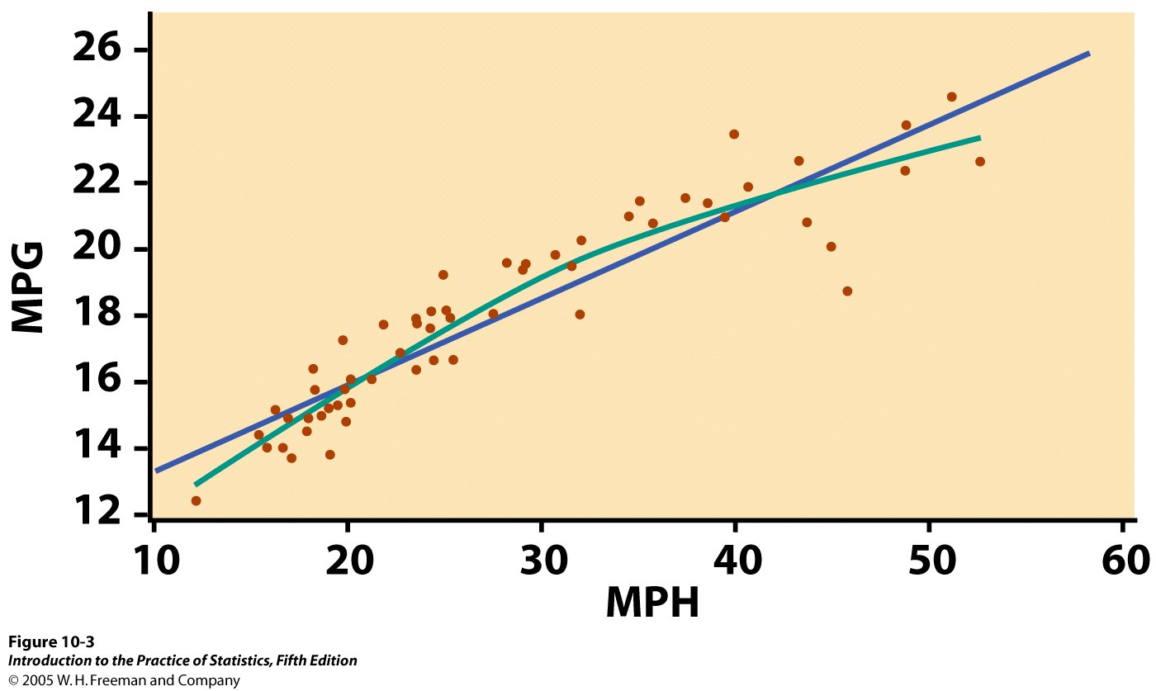
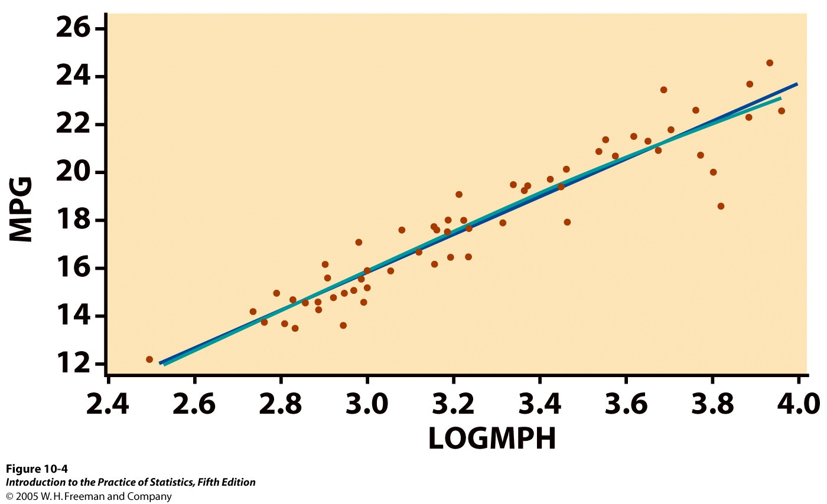

What is the relationship between the average speed a car is driven and its fuel efficiency?
We plot fuel efficiency (in miles per gallon, MPG) against average speed (in miles per hour, MPH) for a random sample of 60 cars. The relationship is curved.
When speed is log transformed (log of miles per hour, LOGMPH) the new scatterplot shows a positive, linear relationship.

Slide 11
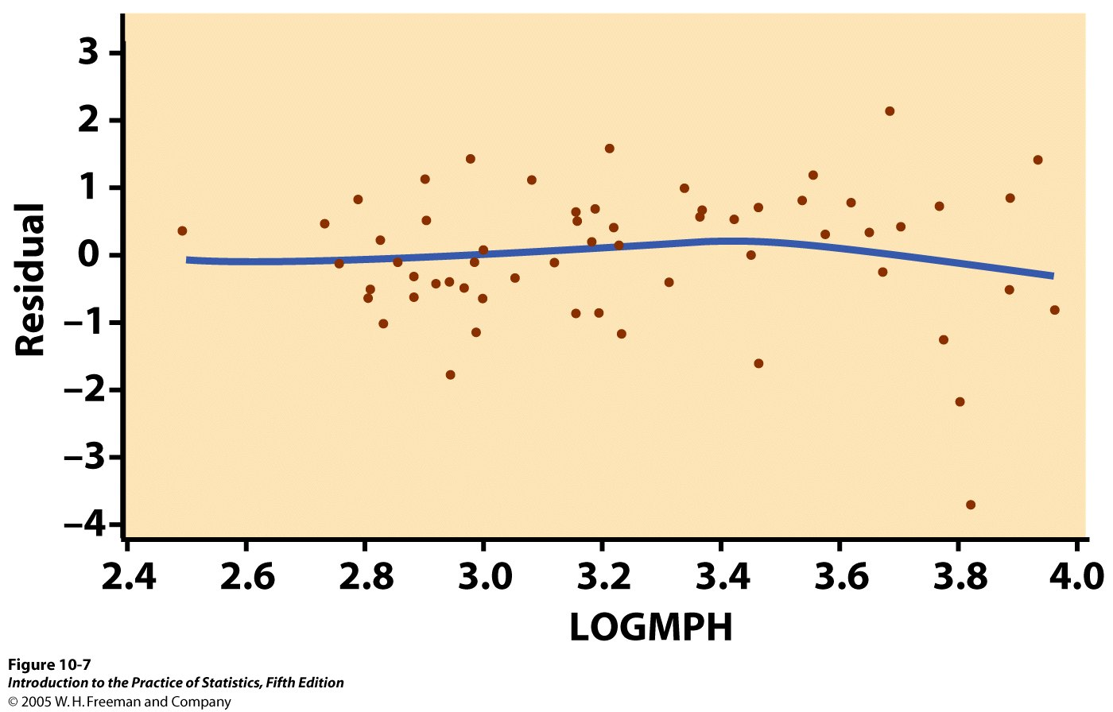
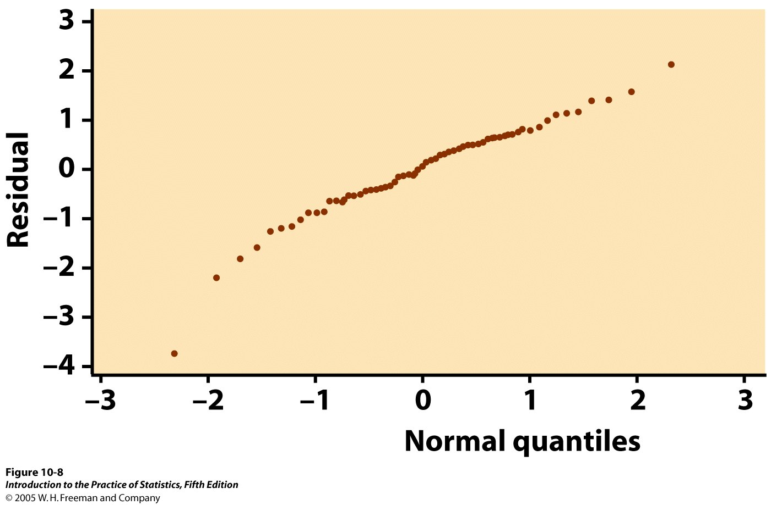
Residual plot:
The spread of the residuals is reasonably random—no clear pattern. The relationship is indeed linear.
But we see one low residual (3.8, −4) and one potentially influential point (2.5, 0.5).
Normal quantile plot for residuals:
The plot is fairly straight, supporting the assumption of normally distributed residuals.
➔ Data okay for inference.

Slide 12
Probability Plot
Subtract mean, divide by standard deviation
Assign each data point a position number, i. (If you have two data points with the same value, they get different values of i.)
Use these values of i to calculate probabilities: pi = (i – 0.5)/n
Use the standard normal distribution to find the standard normal quantiles, that is, the value of “z” that corresponds to each value of “p”
Plot the sorted data vs. the standard normal quantiles (or “z-scores”)
Non-normal distributions are deviate from normality in one of three ways:
The frequency of values in the tails is lower than expected (light-tailed).
The frequency of values in the tails is higher than expected (heavy-tailed).
The distribution is skewed.

Slide 13
Coefficient of Determination
It establishes how much of the variance of the response (dependent variable) variable is caused by the independent variable
We want R²>0.5, 0.7 is better

Slide 14
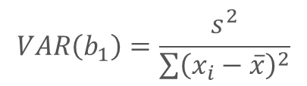
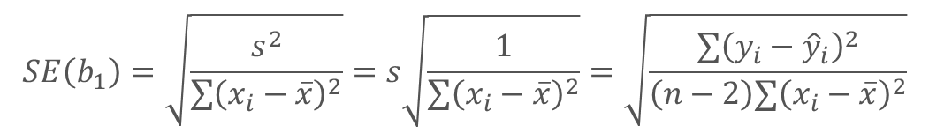
Confidence Intervals
The only important confidence interval is the slope
The intercept is not important. It might not even be achievable
If the confidence interval contains 0, then we cannot say there is a linear relationship between the variables
$$VAR\left(b_{1}\right)=\frac{s^{2}}{\sum{{\left(x_{i}−\overline{x}\right)}^{2}}}$$
$$SE\left(b_{1}\right)=\sqrt{\frac{s^{2}}{\sum{{\left(x_{i}−\overline{x}\right)}^{2}}}}=s\sqrt{\frac{1}{\sum{{\left(x_{i}−\overline{x}\right)}^{2}}}}=\sqrt{\frac{∑{\left(y_{i}−{\hat{y}}_{i}\right)}^{2}}{\left(n−2\right)∑{\left(x_{i}−\overline{x}\right)}^{2}}}$$

Slide 15
Confidence Interval for Regression Parameters
Estimating the regression parameters β₀, β₁ is a case of one-sample inference with unknown population variance.
➔ We rely on the t distribution, with n – 2 degrees of freedom.
A level C confidence interval for the slope, β₁, is proportional to the standard error of the least-squares slope:
b₁ ± t_{n-2,α/2}* SE_{b1}
A level C confidence interval for the intercept, β₀ , is proportional to the standard error of the least-squares intercept:
b₀ ± t_{n-2,α/2}* SE_{b0}
t* is the t critical for the t (n – 2) distribution with area C between –t* and +t*.

Slide 16
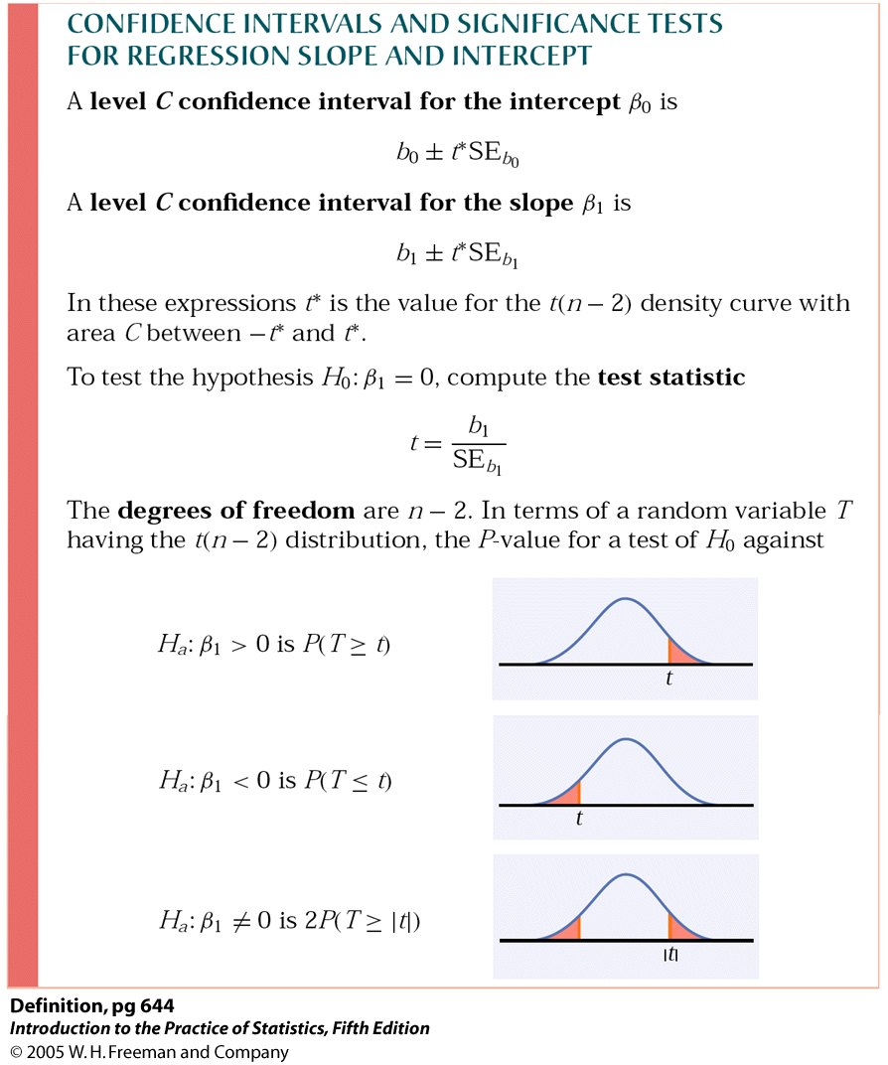

Significance test for the slope
We can test the hypothesis H₀: β₁ = 0 versus a 1 or 2 sided alternative.We calculate
$t=\frac{b_{1}}{SE\left(b_{1}\right)}=\frac{b_{1}}{\sqrt{\frac{∑{\left(y_{i}−\overline{y}\right)}^{2}}{\left(n−2\right)∑{\left(x_{i}−\overline{x}\right)}^{2}}}}$
which has the t (n – 2) distribution to find the p-value of the test.
Note: Software typically provides two-sided p-values.

Slide 17
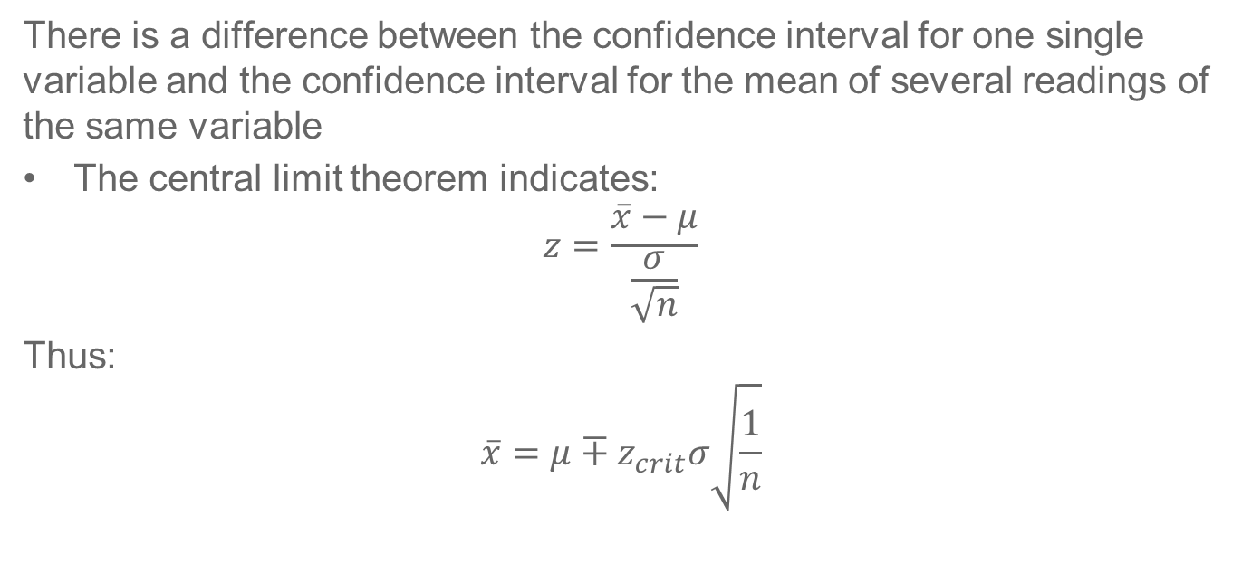
Confidence Interval for Prediction
There is a difference between the confidence interval for one single variable and the confidence interval for the mean of several readings of the same variable
The central limit theorem indicates:
$$z=\frac{\overline{x}−μ}{\frac{σ}{\sqrt{n}}}$$
Thus:
$$\overline{x}=μ∓z_{crit}σ\sqrt{\frac{1}{n}}$$

Slide 18
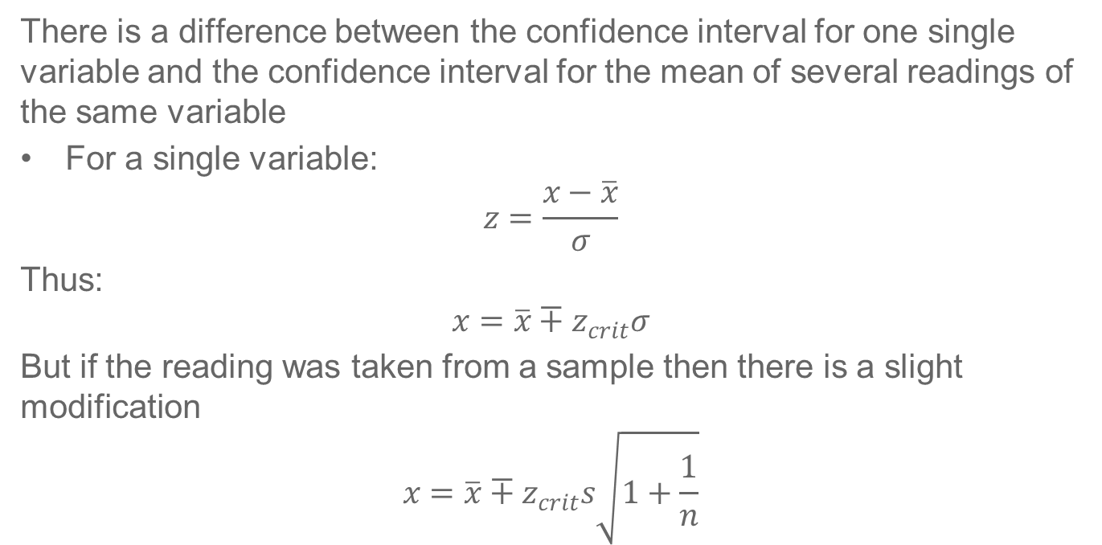
Confidence Interval for Prediction
There is a difference between the confidence interval for one single variable and the confidence interval for the mean of several readings of the same variable
For a single variable:
$$z=\frac{x−\overline{x}}{σ}$$
Thus:
$$x=\overline{x}∓z_{crit}σ$$
But if the reading was taken from a sample then there is a slight modification
$$x=\overline{x}∓z_{crit}s\sqrt{1+\frac{1}{n}}$$

Slide 19
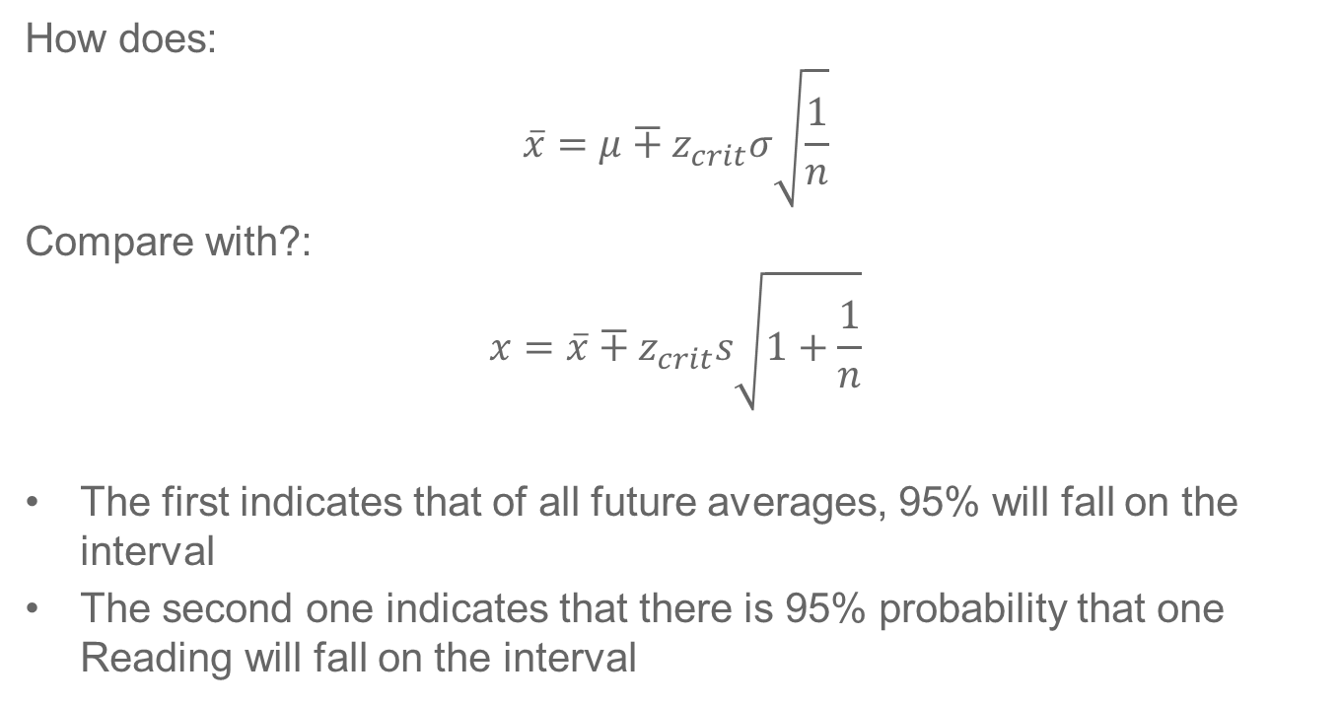
Confidence Interval for Prediction
How does:
$$\overline{x}=μ∓z_{crit}σ\sqrt{\frac{1}{n}}$$
Compare with?:
$$x=\overline{x}∓z_{crit}s\sqrt{1+\frac{1}{n}}$$
The first indicates that of all future averages, 95% will fall on the interval
The second one indicates that there is 95% probability that one Reading will fall on the interval

Slide 20


Confidence Interval for Prediction
The expected value of prediction is obtained by the model with the estimates of intercept and the slope:
It takes into account the estimation error and thus gives rise to the confidence interval
for the expected value y₀ = α+β x₀.
$$SS_{x}=\left(n−1\right)σ_{x}^{2}$$

Slide 21

Prediction Interval Single Reading
However, y₀ is subject to observation error. The observational error has standard deviation σ, and the prediction interval should take this source of variation into account, too. Intuitively, this corresponds to adding s to the residual standard error. Hence, the 95% prediction interval is computed as follows:
The interpretation is that a (new) random observation with x = x₀ will belong to this interval with probability 95%.

Slide 22
Confidence and Prediction Intervals
Interpretation. The confidence interval includes the expected values that are in accordance with the data (with a certain degree of confidence), whereas a new observation will be within the prediction interval with a certain probability.
Interval widths. The prediction interval is wider than the corresponding confidence interval.
Dependence on sample size. The confidence interval can be made as narrow as we want by increasing the sample size. This is not the case for the prediction interval.

Slide 23
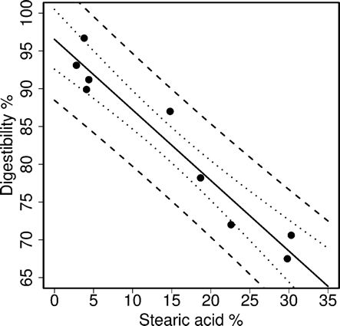
Example: Stearic acid and digestibility
Predicted values (solid line), pointwise 95% prediction intervals (dashed lines), and pointwise 95% confidence intervals (dotted lines) for the digestibility data.
The prediction intervals are wider than the confidence intervals. Also notice that the confidence bands and the prediction bands are not straight lines: the closer x₀ is to the mean value, the more precise the prediction—reflecting that there is more information close to the mean.

Slide 24

www.unir.net

